Slide 1
Indoor positioning system

Slide 2
Motivation
Location and tracking of people or objects where GPS and other satellite technologies lose power or fail entirely.
The GPS and other similar Global Navigation Satellite Systems are generally not suitable to establish indoor locations, since microwaves will be attenuated and scattered by roofs, walls and other objects.

Slide 3
Use cases
Indoor navigation
Indoor tracking and monitoring of people (predict the route)
Equipment tracking (location)
Covid-19 tracking
Track whether person with Covid-19 meets other people
Check whether person is vaccinated
Check whether person has mask

Slide 4
Where to use
Airports
Museums
Schools
Shopping malls
Parking garages
Underground locations (e.g. metro, garage etc.)
Hotels
Warehouses
Hospitals
Industries

Slide 5
Identification when entering
Types of an identification of a person at the entrance:
Identification card (isic, student card, key-card etc.)
Possible problem could be that we only can identify a person, but not track his movements. In this case we could track movements via cameras.
smartphone (NFC)

Slide 6
Indoor identification and tracking
Types of an identification of a person inside the building:
smartphone (sensors)
digital video cameras (IP, CCTV etc.)
Wi-Fi based positioning system (WPS) (using of service set identifier (SSID) and MAC address)
Bluetooth
Magnetic positioning (Magnetic positioning)
Decoding location coordinates from visual markers. Markers are placed at specific locations throughout a venue, each marker encoding that location's coordinates: latitude, longitude and height off the floor.
Radio-frequency identification (might be very useful, need to learn more about it)
Shape of a person (heigh, shoulder width etc.)
Combination of Wi-Fi, Bluetooth, outputs from gyroscope, compass, altimeter and accelerometer
P.S. Bold cases are the most interesting

Slide 7
Scenario examples

Slide 8
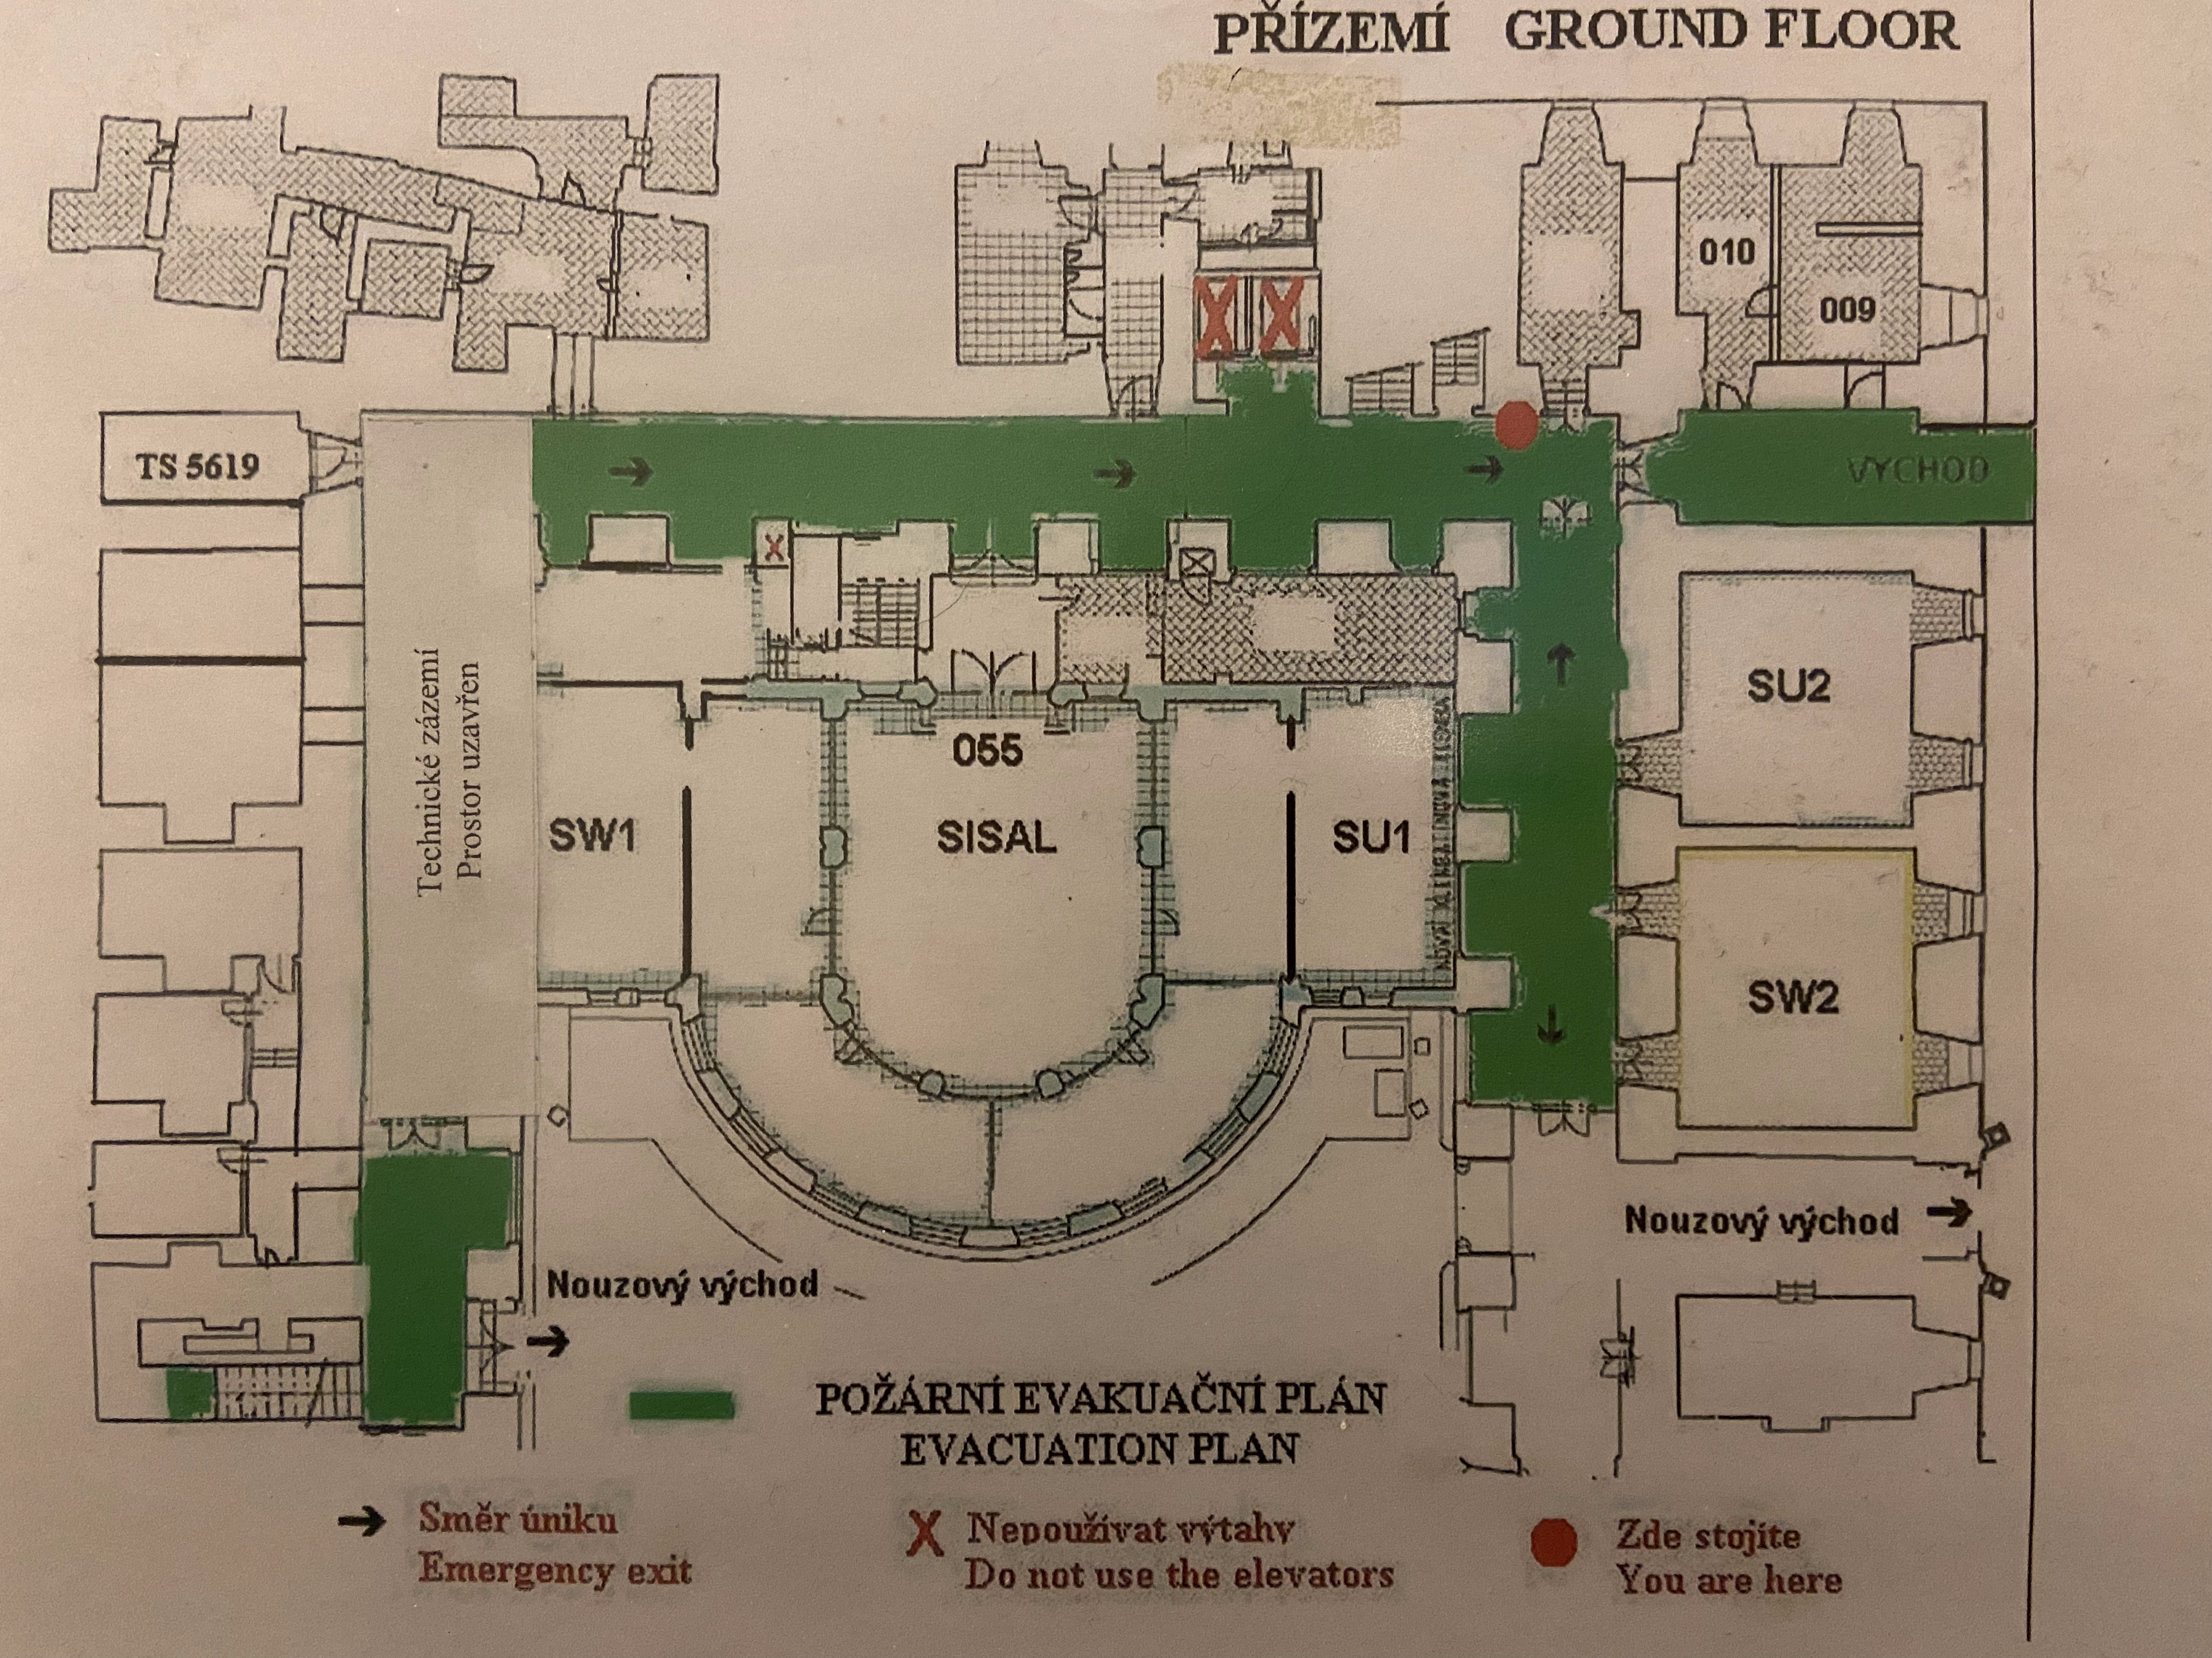
Scenario 1
(indoor tracking and monitoring)
camera
identification of a person at the entrance (using methods described on 5th slide)
3
1
2
entrance door
4

Slide 9
Scenario 1 (indoor tracking and monitoring)
Person comes to the building ( )
He is using his isic card or smartphone (NFC) to open the door and identify himself
After this step, person enters inside the building and system recognizes him using Camera 1. By this step system could start tracking the person (his route). Thanks to the previous step (identification via isic or phone), recognition becomes more accurate
Then we track his routes using cameras 2, 3 and 4 or other sensors described on 6th slide

Slide 10
Scenario 2
(indoor tracking and monitoring Covid-19, meeting)
camera
identification of a person at the entrance (using methods described on 5th slide)
3
1
2
entrance door
2m
4

Slide 11
Scenario 2 (indoor tracking and monitoring Covid-19, meeting)
2 people enter the same corridor
Camera 4 checking whether they have 2m distance between each other
In case they have less than 2m distance or if they don’t have to meet at all, system sends alert to them and the security (via application or sms)

Slide 12
Scenario 3
(indoor tracking and monitoring Covid-19, mask)
camera
identification of a person at the entrance (using methods described on 5th slide)
1
entrance door

Slide 13
Scenario 3 (indoor tracking and monitoring Covid-19, mask)
When person is entering the building, even before the door where isic or smartphone is used to unlock it, our system checks wether person has mask

Slide 14
Scenario 4
(indoor navigation)
camera
3
1
2
4

Slide 15
Scenario 4 (indoor navigation)
Person needs to find a way from elevator to the room (e.g. SU2)
Application generates the route to get the destination

Slide 16
Extensions
To show the position of the person at the given moment on a map or plan of a building (track the motion)
To predict and show the possible routes of a tracked person
Find and book the room (or find shop inside shop malls)

Slide 17
Literature
https://en.wikipedia.org/wiki/Indoor_positioning_system
https://en.wikipedia.org/wiki/Wi-Fi_positioning_system
https://en.wikipedia.org/wiki/Bluetooth_low_energy_beacon (Indoor navigation)
https://en.wikipedia.org/wiki/Magnetic_positioning
https://www.inpixon.com/use-cases
https://www.inpixon.com/technology
https://situm.com/en

